Slide 1
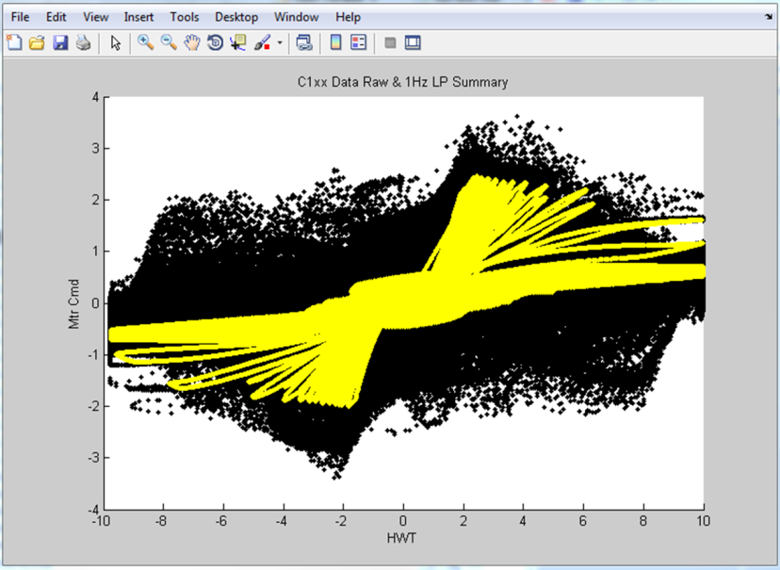
SE02 – Global Cross Check
Description
Input torque to Output command correlation diagnostic for added systematic protection
Not intended to enforce safety goal
Motivation (Score 4)
Requested by GM on K2xx, required for C1xx
Deliverables
Modeled FDD including test plan and calibration strategy
Successful implementation on C1xx and BMPV
Timing
PSA Software Release 2 (FDD must be approved by June 15)
C1xx – targeting post-IVER release
Team Members/Customers
Scott Weiss / C1xx and PSA PDT

Slide 2
SE02 – Global Cross Check
Status
Modeled results and aggressive test stand measured data indicate the strategy can work
Key to getting a useful range is to filter the signals at 1 Hz
Challenges
Reduced value since it does not enforce the safety goal
Next Steps
Implement in PSA and GM vehicles and evaluate for robustness
Create a calibration procedure
Eventually replace this function with true ASIL decomposition over time

